Slide 1


SOFTWARE Design & Analysis (Week-3)
Usama Musharaf
MS-CS (Software Engineering)
Lecturer (Department of Computer Science)
FAST-NUCES Peshawar

Slide 2
Agenda of week # 3
Requirement Engineering (Cont…)
Analysis Modeling with UML
Object Oriented Analysis
Modeling with UML (Static and Dynamic Models)
Design Principles and Concepts
Assignment # 1

Slide 3
The Requirements Process (Process for Capturing Requirements)
Performed by the req. analyst or system analyst
The final outcome is a Software Requirements Specification (SRS) document

Slide 4
Analysis Modeling

Slide 5
Elements of the Analysis Model
Object-oriented Analysis
Structured Analysis
Scenario-based
modeling
Flow-oriented
modeling
Use case text
Use case diagrams
Activity diagrams
Data structure diagrams
Data flow diagrams
Class-based
modeling
Behavioral
modeling
Class diagrams
CRC models
Collaboration diagrams
State diagrams
Sequence diagrams

Slide 6
Unified Modeling language (UML)

Slide 7
What is UML
UML is the “Unified” Modelling Language”.
Standard modelling language for software development.
Maintained by Object Management Group.

Slide 8
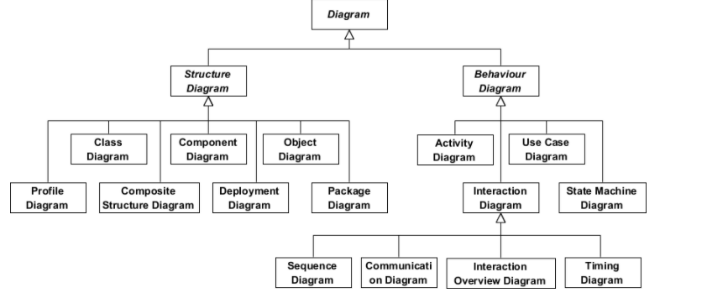

Slide 9
View of the model
Logical view
Process view
UML model diagrams can be broken into different perspective or view.
Can be explained through kruchen’s 4+1 Model.
Use Case
View
Physical view
Development View

Slide 10
Logical view
The logical view shows the parts that make up the system and how they interact with each other.
It represents the abstractions that are used in the problem domain
These abstractions are classes and objects
Different UML diagrams show the logical way such as class diagram state diagram sequence, diagram communication diagram and object diagram.
Logical view
class diagram
state diagram
Sequence diagram
communication diagram
object diagram

Slide 11
Process View
Then we have the process view
Through this view, we can describe the processes of the system and how they communicate with each other using process
Using process view, we can find out what needs to happen to the system
So using process view we can understand the overall functioning of the system
Activity diagram in UML represents the process view
Process view
Activity Diagram

Slide 12
Physical View
Next is physical view
The physical view is the view that models the execution environment of the system
Using this view, we can model the software entities onto the hardware that will host and run the entities
The physical view in UML is represented through deployment diagrams
Physical view
Deployment Diagrams

Slide 13
Development View
The development view describes the modules are the components of the system.
This might include packages or libraries.
It gives a high-level view of the architecture of the system and helps in managing the layers of the system.
UML provides two diagrams for development view.
component Diagram
package Diagrams
All these four views are dependent on Use Case view
Development View
Component Diagram
Packages Diagram

Slide 14
Use Case
They use case view illustrates the functionality of the system.
Using use case we can capture the goals of the user or what the user expects from the system.
In UML, Use Cases can be created through use case diagrams or use case descriptions (we will discuss it later).
Use cases can be created by analysts' architects or even by the users.

Slide 15
Scenario-Based Modeling

Slide 16
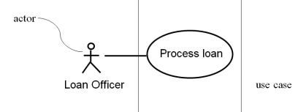
Developing Use Cases
– Define the set of actors that will be involved in the story
Actors are people, devices, or other systems that use the system or product within the context of the function and behavior that is to be described
Actors are anything that communicate with the system or product and that are external to the system itself

Slide 17
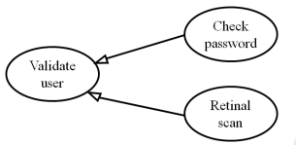
Specialized Use Cases
You may have two specialized children of this use case (Check password and Retinal scan).

Slide 18

Include
Include relationship is used to avoid describing the same flow of events several times, by putting the common behavior in a use case of its own
This is an example of dependency

Slide 19
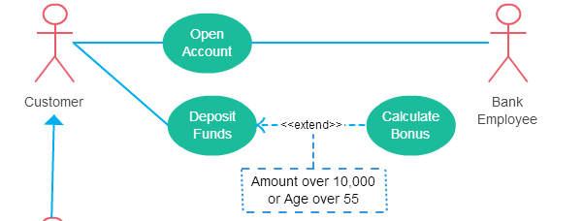
Extend
The extending use case is usually optional and can be triggered conditionally. In the diagram, you can see that the extending use case is triggered only for deposits over 10,000 or when the age is over 55.

Slide 20
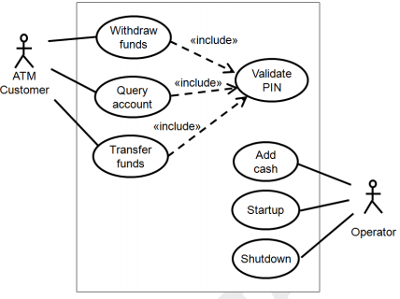
Use case diagram for atm

Slide 21
Use Case Example
Name | Validate PIN
Summary | System validates customer PIN
Dependency | none
Actors | ATM, Customer
Preconditions | ATM is idle, displaying a Welcome message.
Flow of Events | Activity Diagram
Alternatives | If the system does not recognize the card, the card is ejected. If the system determines that the card date has expired, the card is confiscated. If the system determines that the card has been reported lost or stolen, the card is confiscated. If the customer-entered PIN does not match the PIN number for this card, the system re-prompts for PIN. If the customer enter the incorrect PIN three times, the system confiscates the card. If the customer enters Cancel, the system cancels the transaction and ejects the card
Post condition | Customer PIN has been validated.

Slide 22
Behavioral Modeling

Slide 23
Activity diagram
An activity diagram in the use-case model can be used to capture the activities and actions performed in a use case.
It expresses the dynamic aspect of the system.

Slide 24
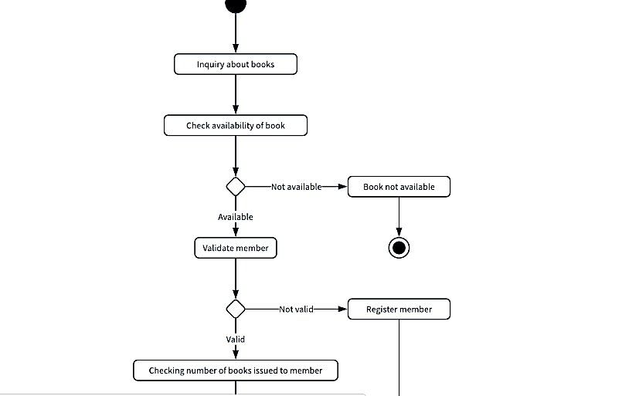
Activity diagram

Slide 25
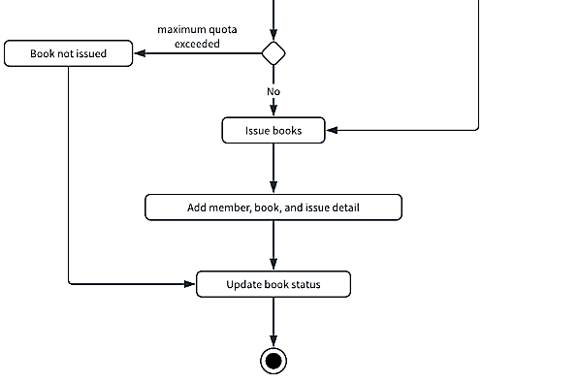
Activity diagram

Slide 26
Swimlane diagram
Mapping Who Does What to Whom
You are assigning a responsibility to an actor.
Note, we did not say to an object - to an actor.

Slide 27
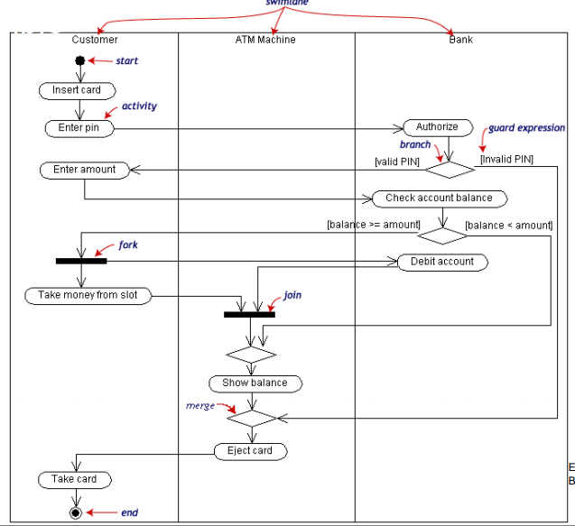
Swimlane Diagram

Slide 28
State Machine Diagram
A state machine diagram models dynamic behavior.
It specifies the sequence of states in which an object can exist:
The events and conditions that cause the object to reach those states.
The actions that take place when those states are reached.

Slide 29
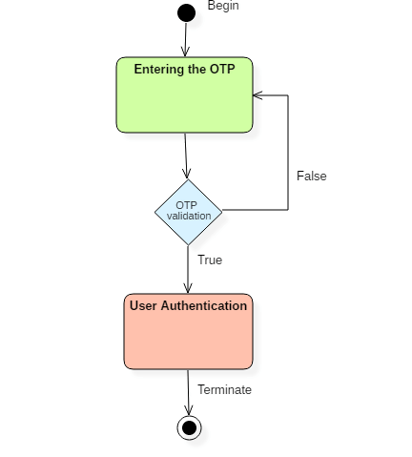
Element of State Machine Diagram
States
Events
Transition
An object has state, behavior, and a unique identity.
An object goes through various states during its lifespan.

Slide 30
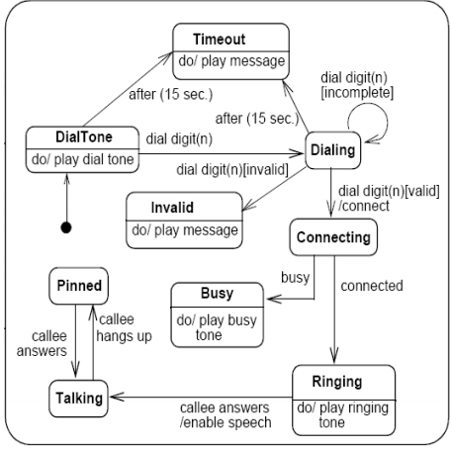
State Machine Diagram

Slide 31
Sequence diagram
A sequence diagram shows object interactions.
It depicts the objects involved in the scenario and the sequence of messages exchanged between the objects needed to carry out the functionality of the scenario.

Slide 32
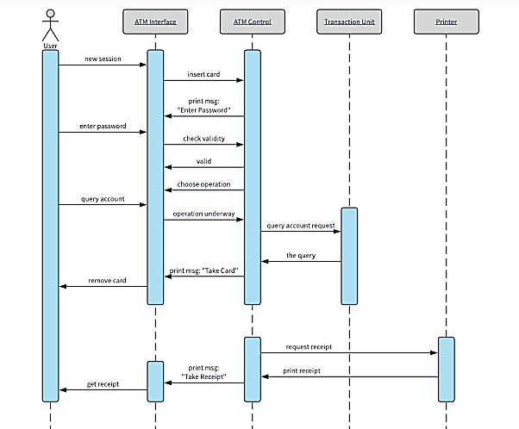

Slide 33
System Sequence Diagram

Slide 34
Design principles

Slide 35
Design Principles
1- The design process should not suffer from “tunnel vision.”
A good designer should consider alternative approaches, judging each based on the requirements of the problem, the resources available to do the job, and the design concepts.
2- The design should be traceable to the analysis model.

Slide 36
Design Principles
3- The design should not reinvent the wheel.
Systems are constructed using a set of design patterns.
These patterns should always be chosen as an alternative to reinvention.
Time is short and resources are limited!

Slide 37
Design Principles
4- The design should “minimize the intellectual distance” between the software and the problem as it exists in the real world.
5- The design should exhibit uniformity and integration

Slide 38
Design Principles
6- The design should be structured to accommodate change
7- The design should be assessed for quality as it is being created

Slide 39
Design Concepts

Slide 40
Fundamental Concepts of Design
abstraction—data, procedure, control
refinement—elaboration of detail for all abstractions
modularity—compartmentalization of data and function
architecture—overall structure of the software
Styles and patterns
procedure—the algorithms that achieve function
hiding—controlled interfaces

Slide 41
Abstraction
“Capture only those details about an object that are relevant to current perspective”
Suppose we want to implement abstraction for the following statement,
“Ali is a PhD student and teaches BS students”
Here object Ali has two perspectives one is his student perspective and second is his teacher perspective.

Slide 42
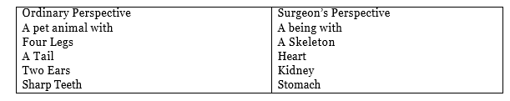
Abstraction
A cat can be viewed with different perspectives.

Slide 43
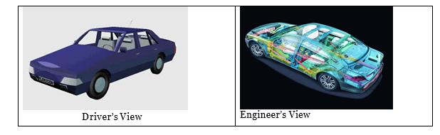
Abstraction
A car can be viewed with different perspectives.

Slide 44
Abstraction Advantages
It helps us understanding and solving a problem using object oriented approach as it hides extra irrelevant details of objects.
Focusing on single perspective of an object provides us freedom to change implementation for other aspects of for an object later.
Abstraction is used for achieving information hiding as we show only relevant details to related objects, and hide other details.

Slide 45
Data Abstraction
door
manufacturer
model number
type
swing direction
inserts
lights
type
number
weight
opening mechanism
implemented as a data structure

Slide 46
Procedural Abstraction
open
details of enter
algorithm
implemented with a "knowledge" of the
object that is associated with enter

Slide 47
Stepwise Refinement
open
walk to door;
reach for knob;
open door;
repeat until door opens
turn knob clockwise;
walk through;
if knob doesn't turn, then
close door.
take key out;
find correct key;
insert in lock;
endif
pull/push door
move out of way;
end repeat

Slide 48
Modular Design
Easier to manage
Easier to understand
Reduces complexity
Delegation / division of work
Fault isolation
Independent development
Separation of concerns
Reuse

Slide 49
Modularity: Trade-offs
What is the "right" number of modules
for a specific software design?
module development cost
cost of
software
module
integration
cost
optimal number
number of modules
of modules

Slide 50
Information Hiding
module
• algorithm
controlled
interface
• data structure
• details of external interface
• resource allocation policy
clients
"secret"
a specific design decision

Slide 51
Information Hiding
Design the modules in such a way that information (data & procedures) contained in one module is inaccessible to other modules that have no need for such information.
Independent modules.
Benefits:
when modifications are required, it reduces the chances of propagating to other modules.

Slide 52
Case Study (Hospital Management System)

Slide 53
Hospital Management System
The Hospital Management System (HMS) is a web application, which used for the control of hospital services.
The HMS web application can be accessed by either mobile or computer browser.
The HMS application combines all details regarding doctors, patients, nurses, hospital administrative, etc. into one software.

Slide 54
Hospital Management System
HMS System allows the patients to register via a registration module (form), which gathers and stores all required patient’s data such as name, e-mail, gender, etc.
Registered patients can skip this step and login directly using their username and password through the login module. Nevertheless, unregistered users can only take advantage of major system features such as viewing the hospital timings.
After the patient creates an account and register, he can access the allowed system features/functionalities for patients.
Patients can view available appointments, book an appointment and manage his/her own profile. After the patient book an appointment, he can visit the hospital according to his appointment.

Slide 55
Hospital Management System
Once the patient reaches the hospital, the receptionist will issue a clinic number for him since the receptionist has access to the system to view the appointments list and status with nurses and doctors.
The HMS system also allows the receptionist to create patient accounts and book an appointment, referring to the doctors’ schedule, for unregistered patients.
Once patient’s turn came, the patient can explain his condition to the consulting nurse, so that the nurse performs the pre-assessment examinations to diagnose the problem and then redirect him to the concerned doctor/clinic.
The HMS system enables the nurse to allot patients for the concerned doctors, to view doctors’ status and to update patients’ account.

Slide 56
Hospital Management System
Then, the concerned doctor will diagnose the patient, and then enter the prescription needed for the patient. If the doctor sees that the patient needs any further examinations like collecting and processing specimens, the system allows the doctor to redirect the patient to the Nurse again.
After the nurse collects the specimens, the specimens will be sent to the laboratory so that the lab assistant can process, analyze the specimens, and then generate and enter the test results into the system.
Furthermore, the doctor can redirect the patient to the lab assistant if there is a need to perform examinations such as X-Ray images, CT scan, MRI. The lab assistant can access the system and generate test reports regarding the examinations or test performed.

Slide 57
Hospital Management System
On the other hand, the doctor keeps track of the examination results entered by the lab assistant and then recommend further actions to be taken if required, as well as enters a new prescription for the patient.
The system also allows the patient to access his account to see prescription details and view his reports along with doctor advice.
This feature is very useful since test reports usually take a long time to be generated, so that the patient may leave the hospital and view the results along with doctor’s advice through his account without the need of going to the hospital again.

Slide 58
Hospital Management System
Once the prescription is ready, the pharmacist will prepare the medicines for the patient and enters the dose and guidelines of each medicine into the system.
When the patient goes to the pharmacy of the hospital, he/she will find the medicines ready so that he/she can pick and go easily.
The patient has two options to know the dose and guidelines of each medicine, either by asking the pharmacist directly or by accessing his/her account to see it.
This will help the patient be aware of the medicines’ dose if he/she forgets it. Finally, the patient will need to go to the cashier to pay for his/her visit.
The system allows the cashier to create and order invoice for payment through the billing module. In addition, the cashier can watch the payment history of the patients.

Slide 59
Assignment # 1
Requirement Analysis
Identify actors and draw use-cases for HMS case study.
Draw Activity Diagram for each use case to capture further details.
Draw Swimlane Diagram to link activities/processes with actors.

Slide 60
HAVE A GOOD DAY!

